Slide 1
Intro to Conversational AI Services
Annie Xu
Manika Tiwari
Wayne Smith
Will Fox

Slide 2
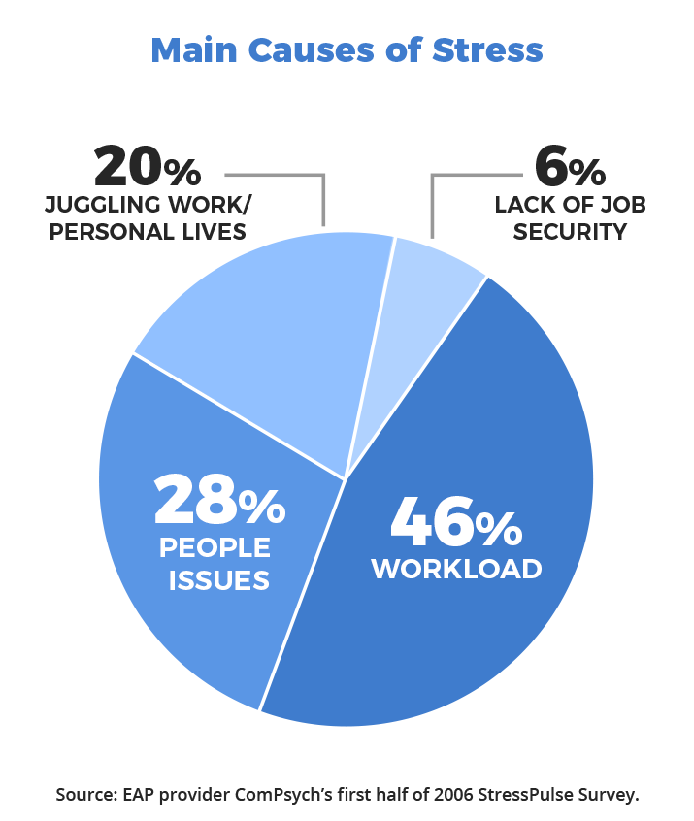

Slide 3
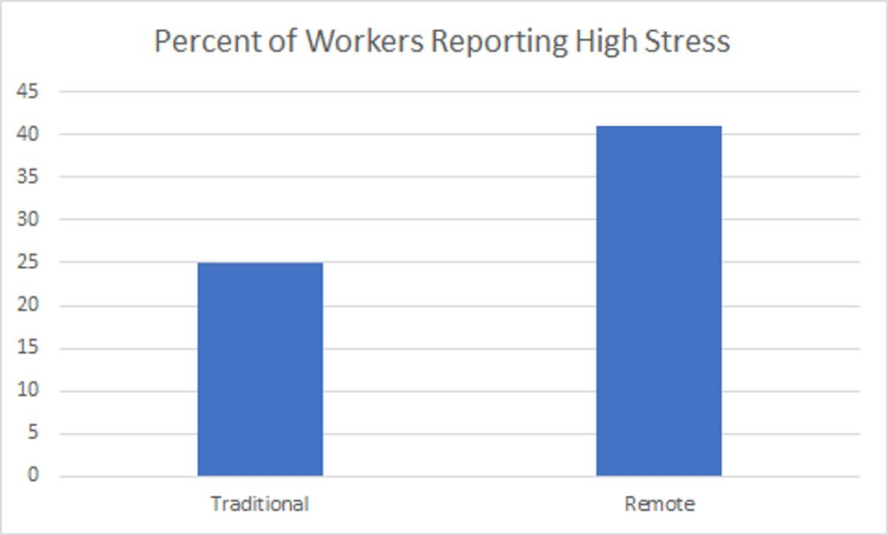
Source: UN Report 2017

Slide 4
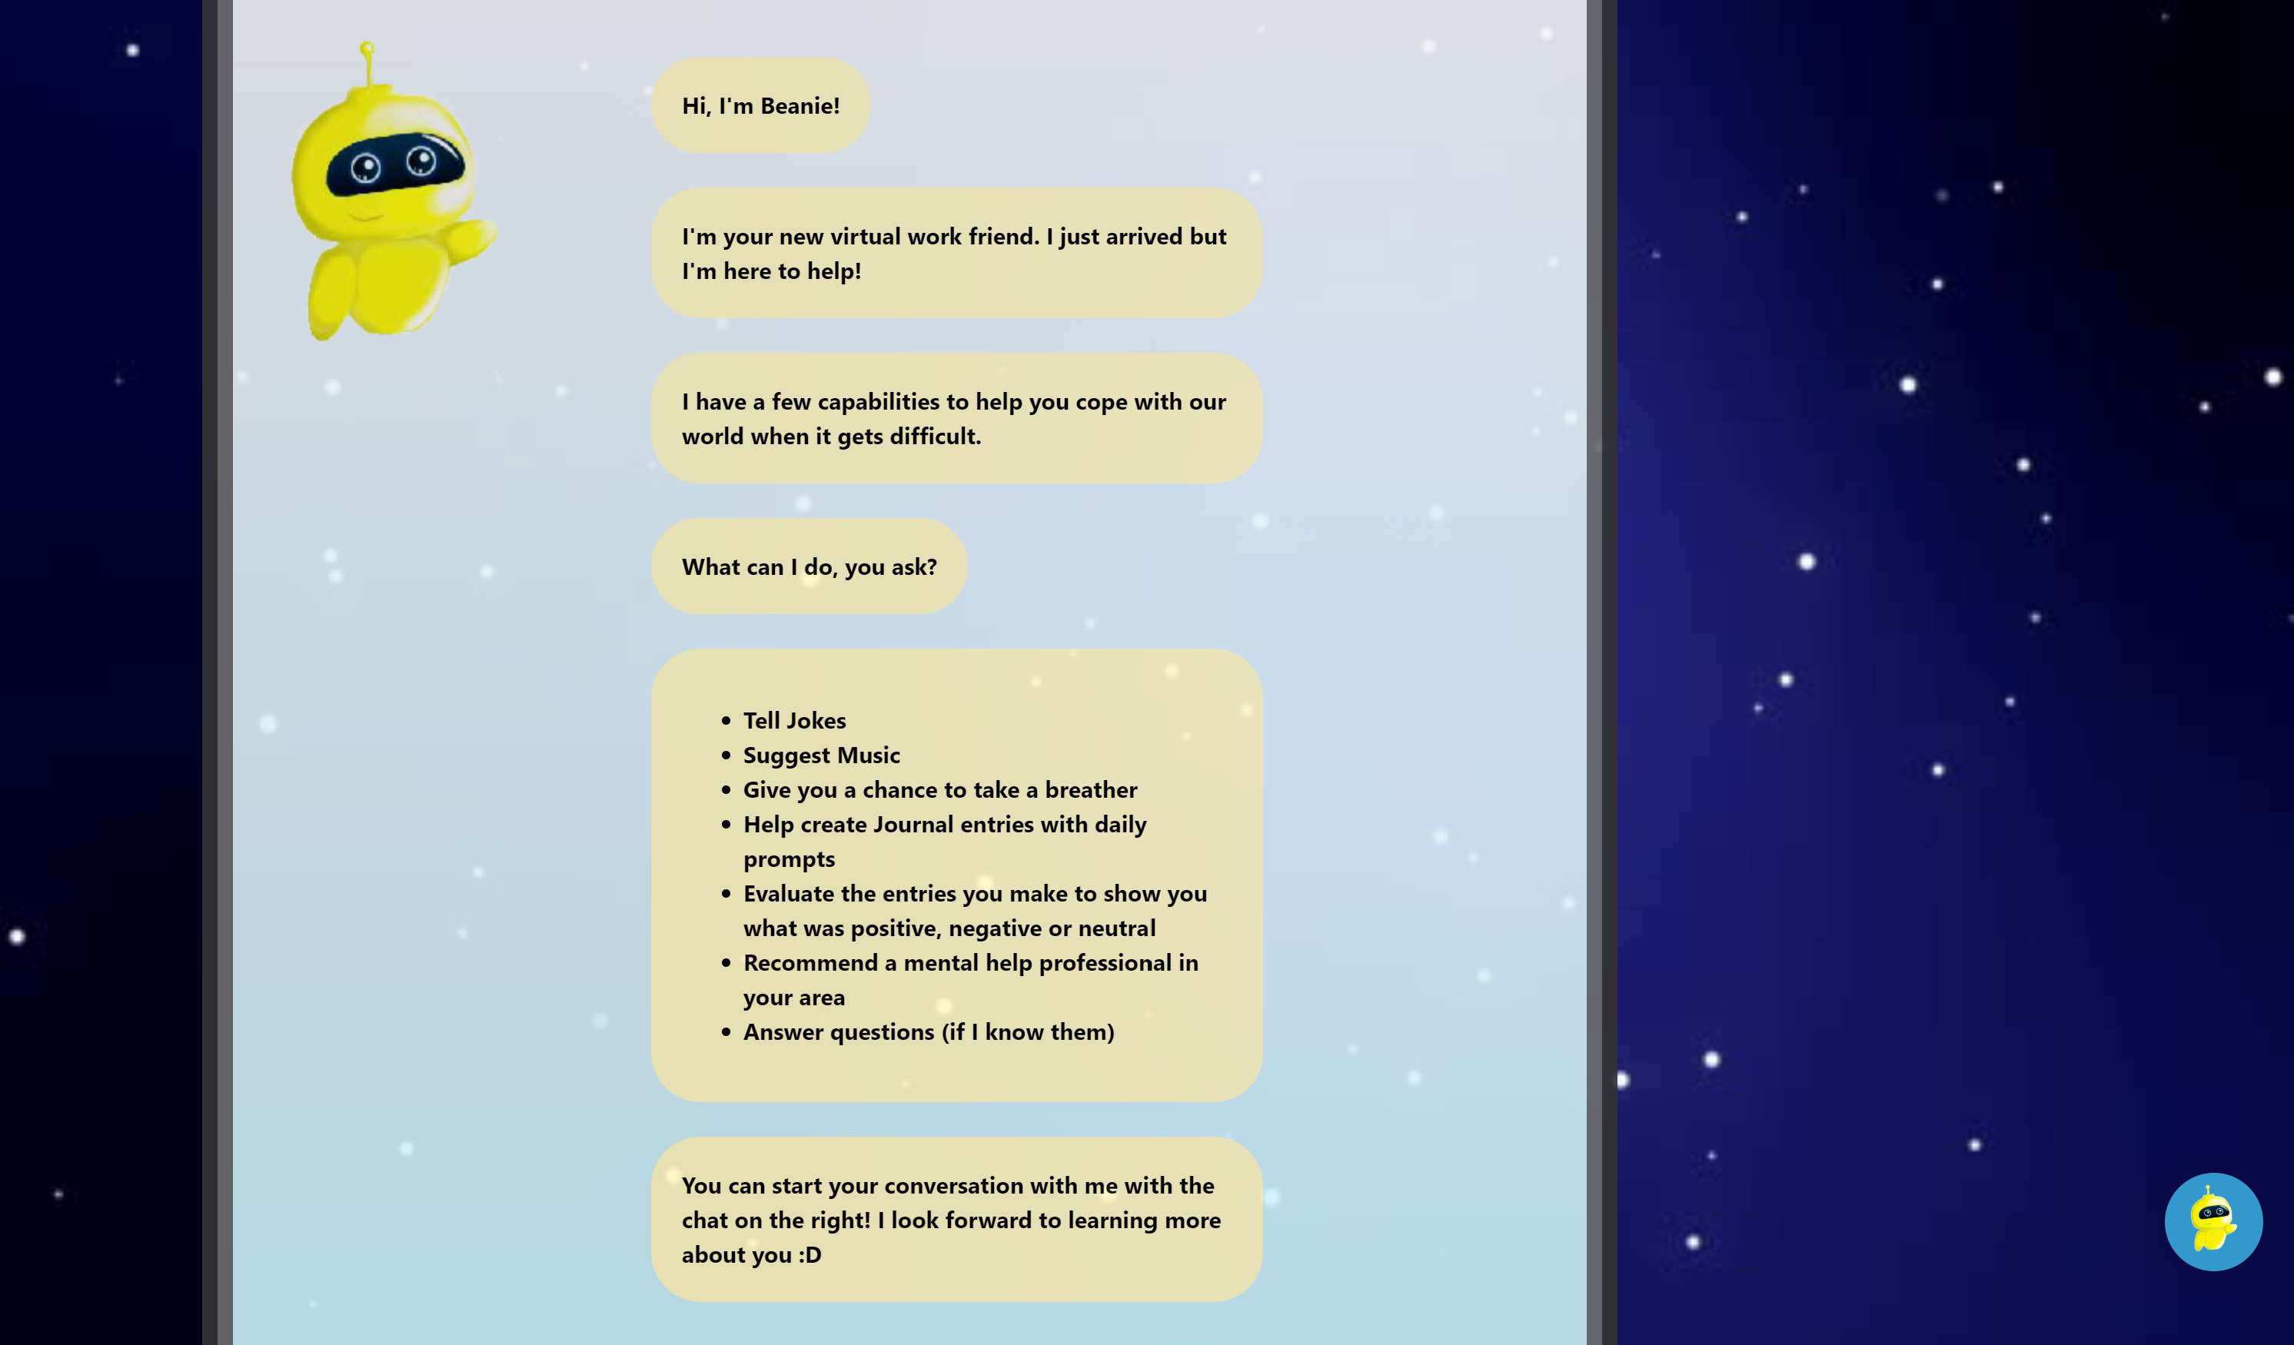

Slide 5
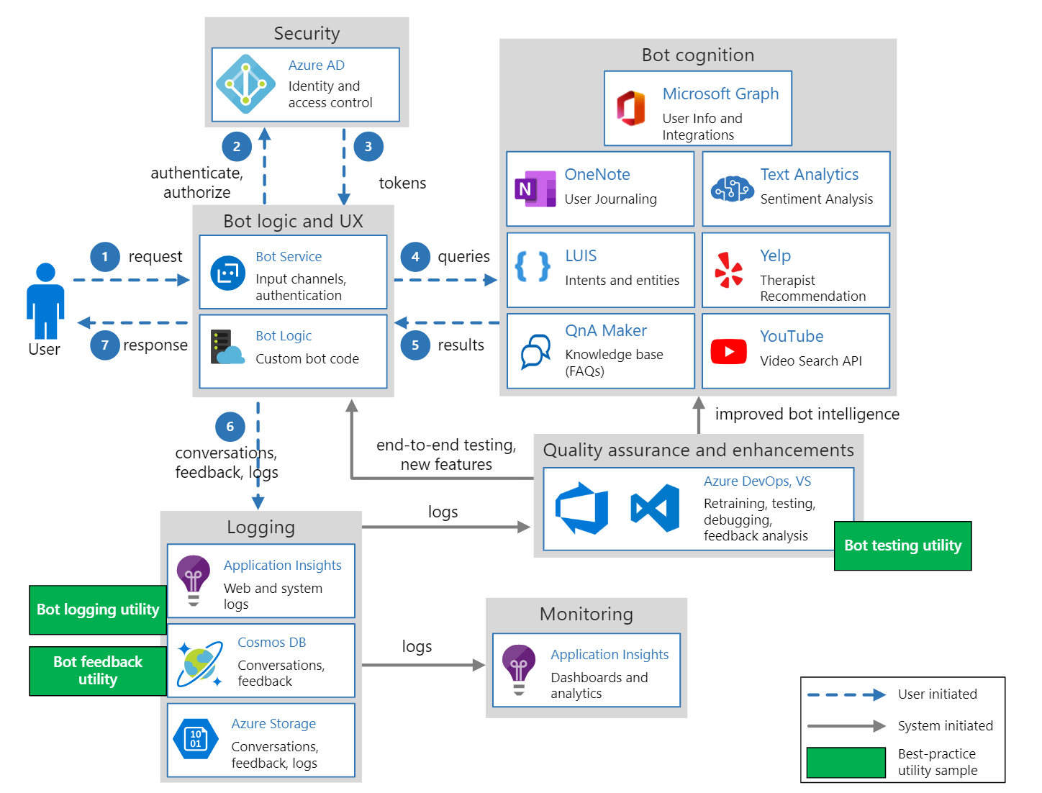

Slide 6
Product Demo

Slide 7
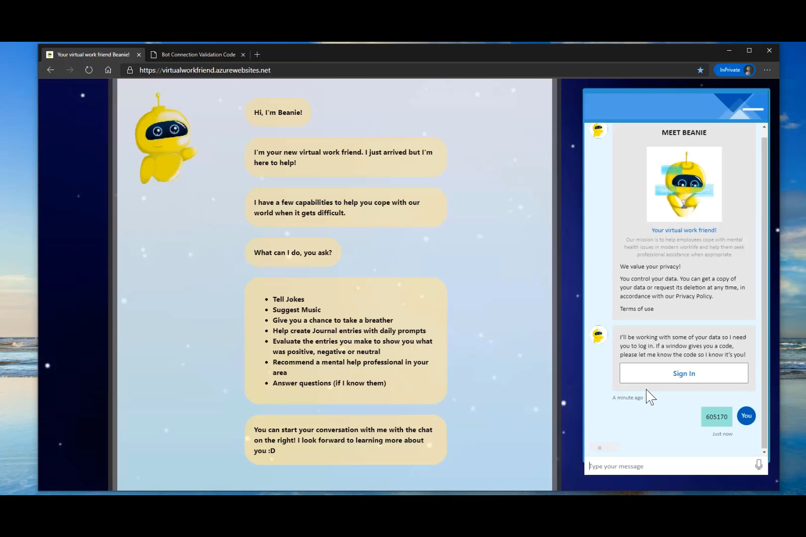
Stress Dialog
Main Logic
Stress Level
High → Mediation + Talk
Medium → Talk
Low → Chitchat
Interruptions Handling
Music
Journaling
Therapist Escalation

Slide 8
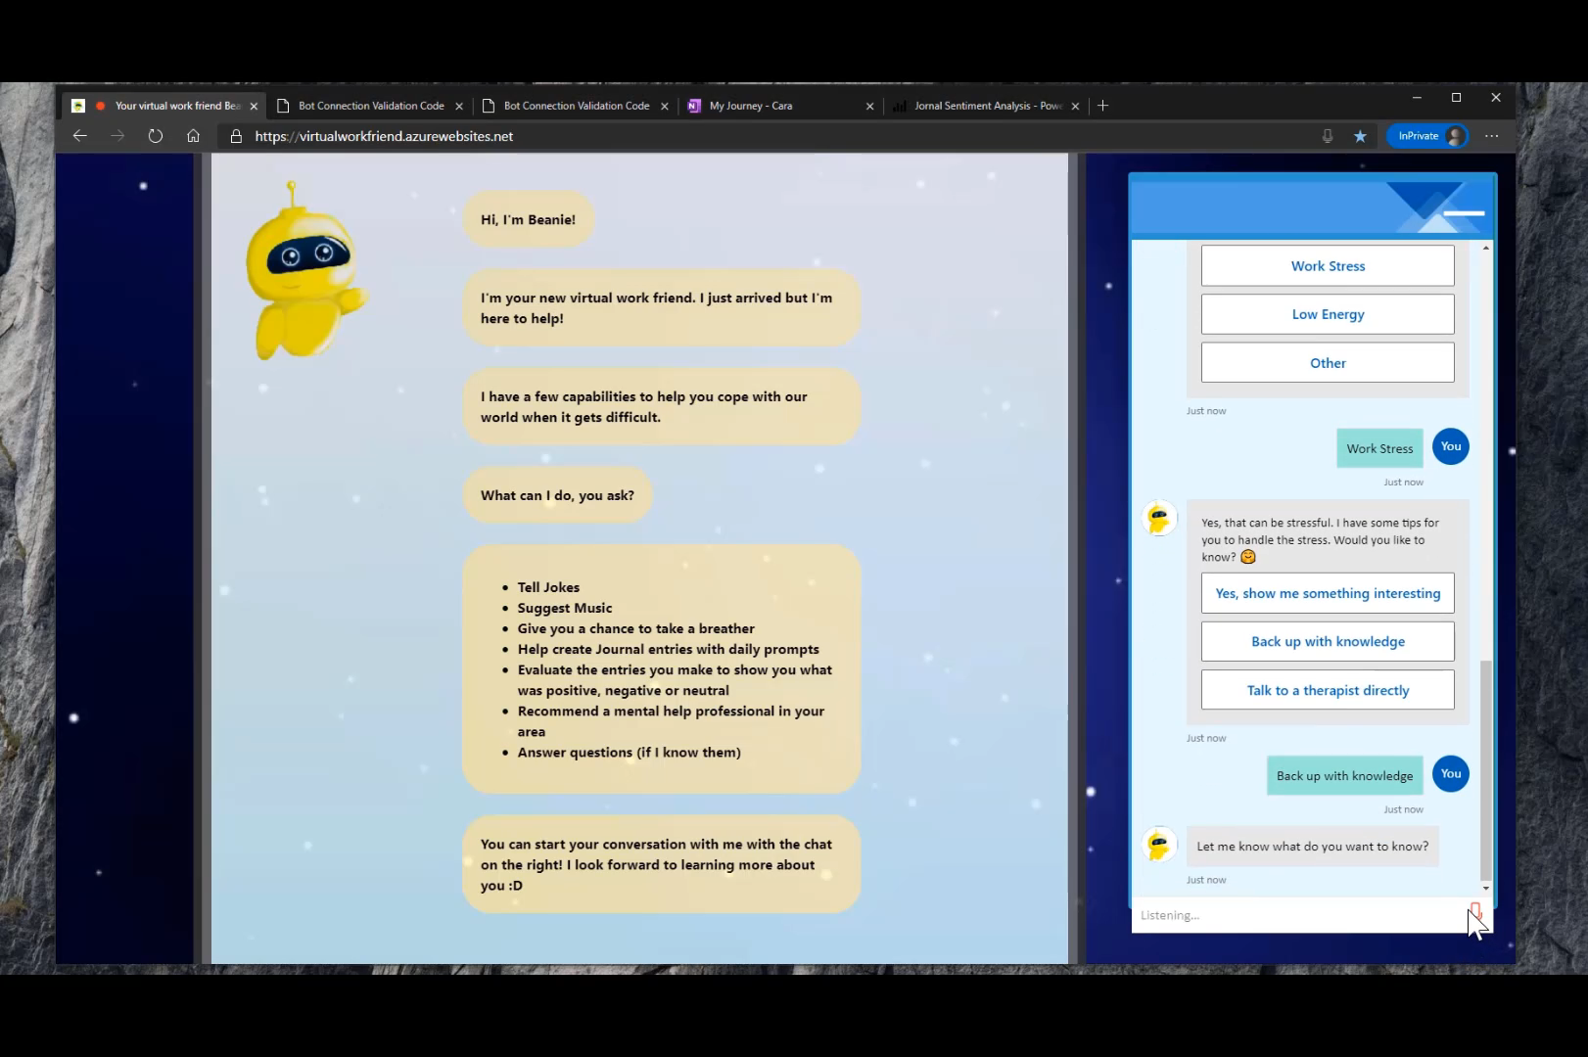
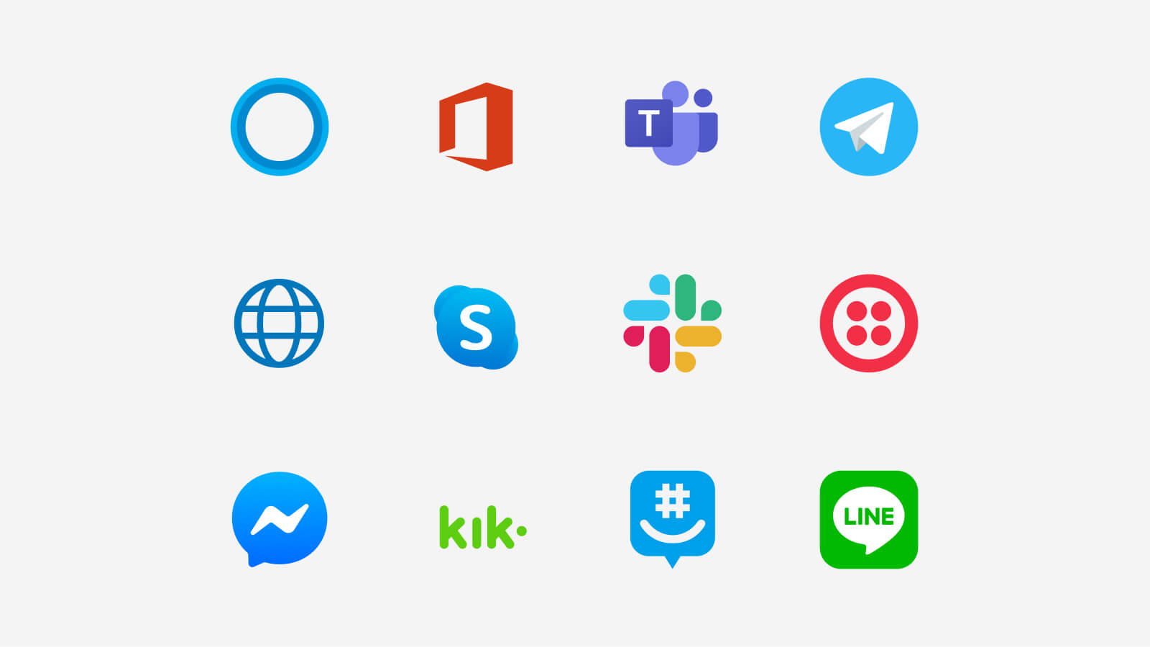
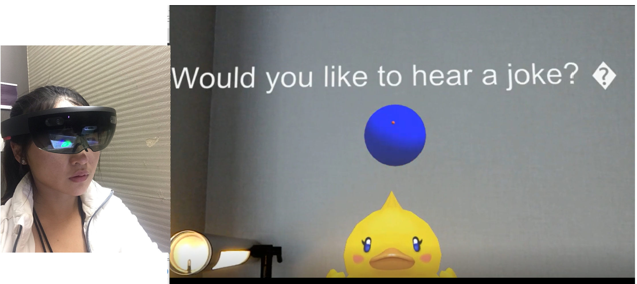
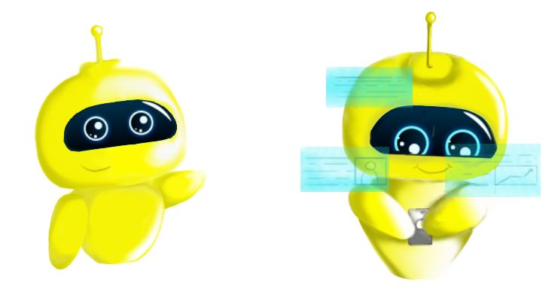
Channels
Would you like to hear a joke?

Slide 9
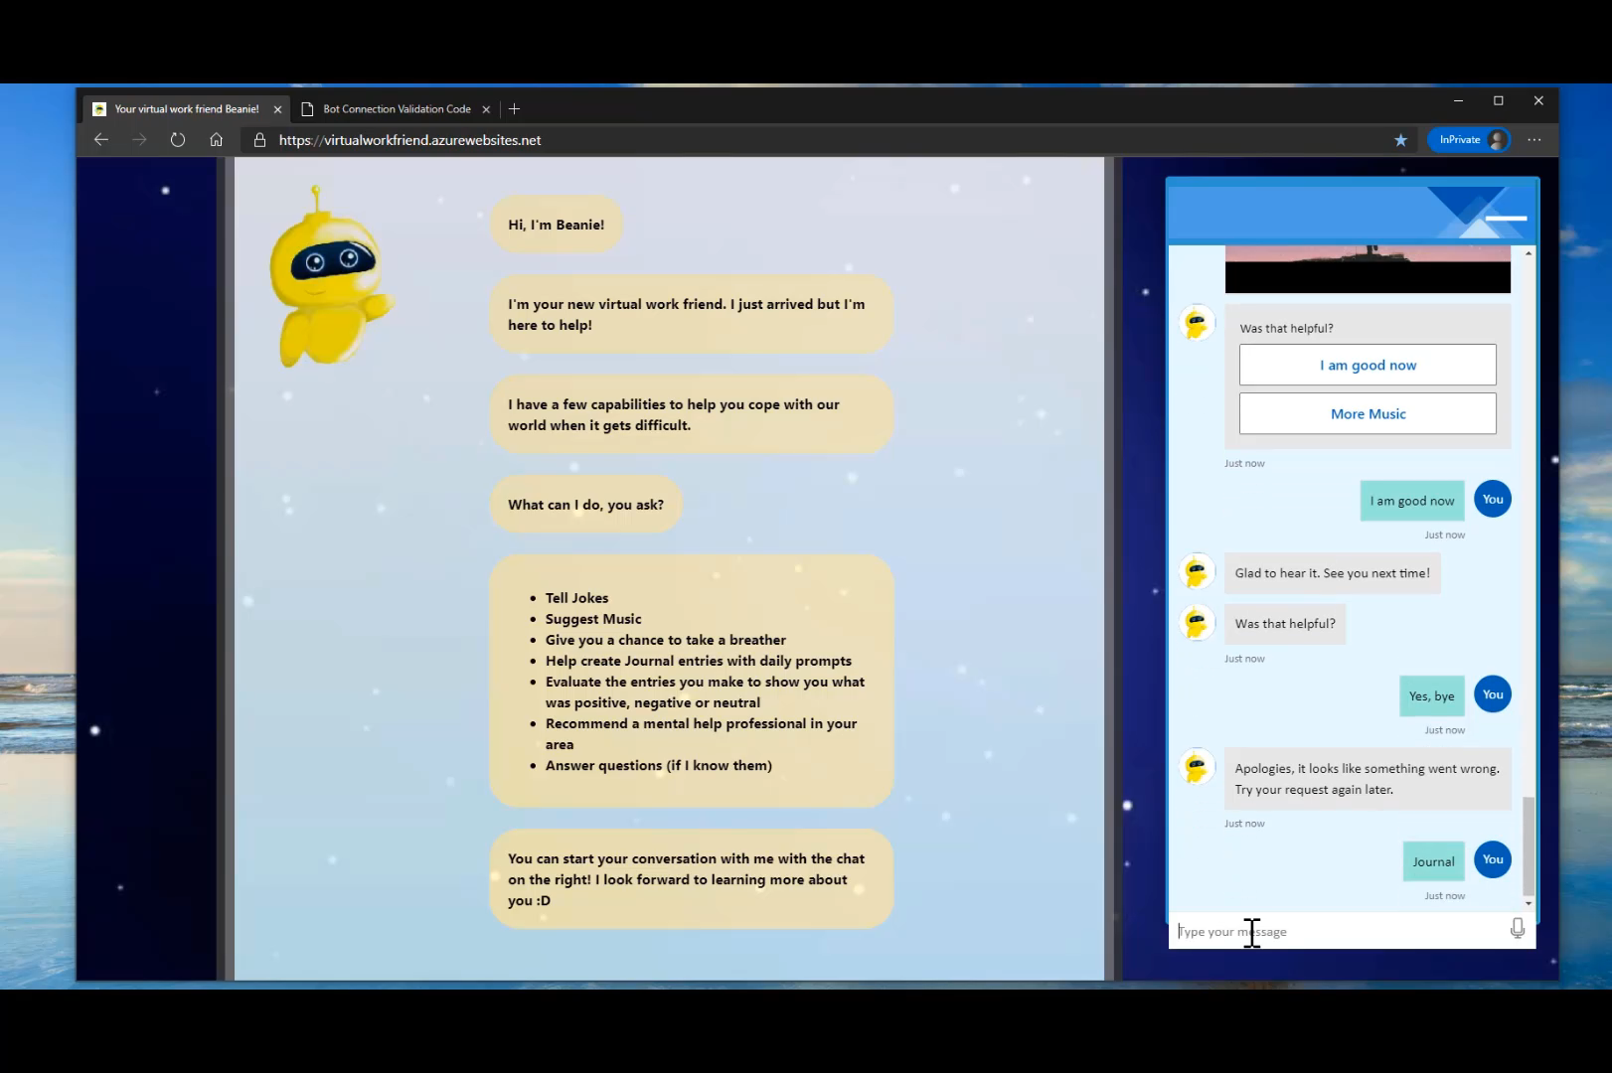

Journaling

Slide 10
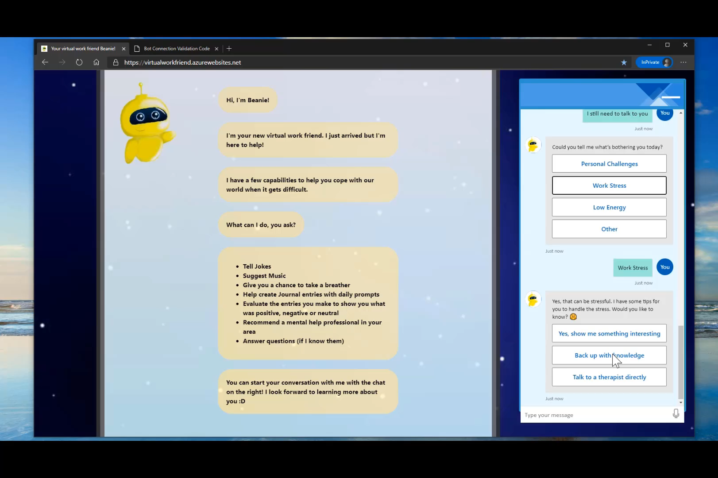
QnA Maker Knowledge Base
Distill information into conversational, easy-to-navigate answers
Extract questions and answers
Test, train, and publish
Integrate with other APIs and solutions
No-code, 3-step KB creation
Add personality to your Bot
Support 50+ languages
Notes:
The first thing in creating any bot is to use the QnA Maker service to create a knowledge base. The service provides a dedicated QnA Maker portal web-based interface that you can use to create, train, publish, and manage knowledge bases. It is a no code solution for creating FAQ based bots.
QnA Maker is a part of azure cognitive service - that enables you to create and publish a knowledge base with built-in natural language processing capabilities.
QnA Maker : Distill information into conversational, easy-to-navigate answers.​
Extract questions and answers​
QnA Maker extracts all possible pairs of questions and answers from user provided content – FAQ URLs, documents and editorial content.​
Test, train and publish​
Through QnA Maker’s easy-to-use GUI, you can edit, remove or add pair before testing and training the knowledge base and publishing your knowledge base as an API endpoint.​
Integrates with other APIs and solutions​
QnA Maker integrates with other APIs seamlessly and at scale. Use QnA Maker with Cognitive Services such as Language Understanding Intelligent Service and create something as elegantly simple as a chat bot that answers FAQs, or as complex as an interactive virtual guide.​

Slide 11
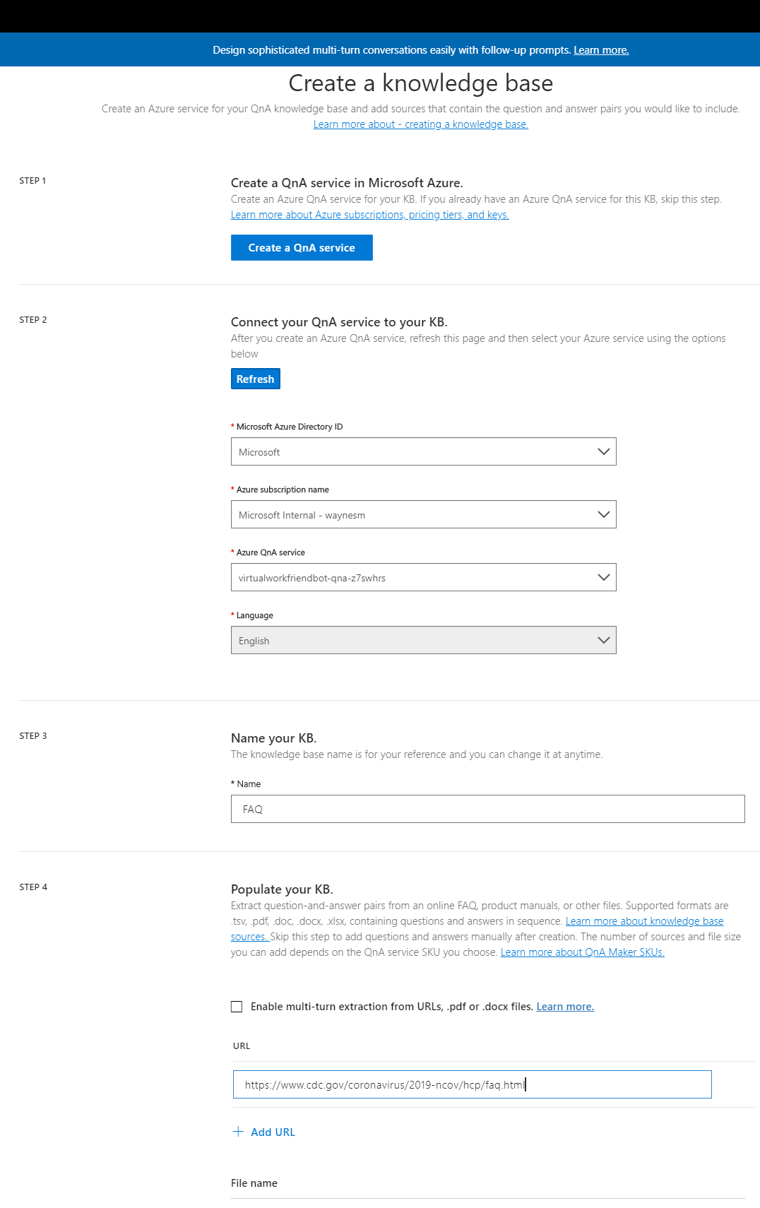
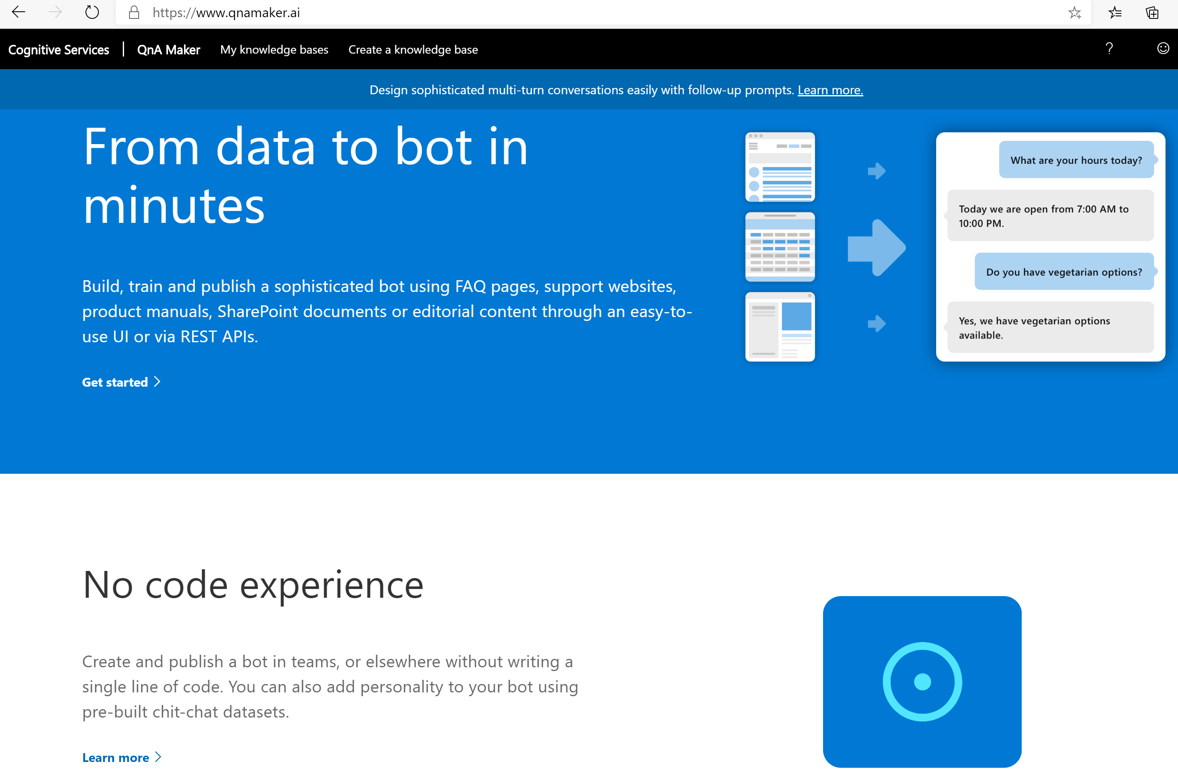
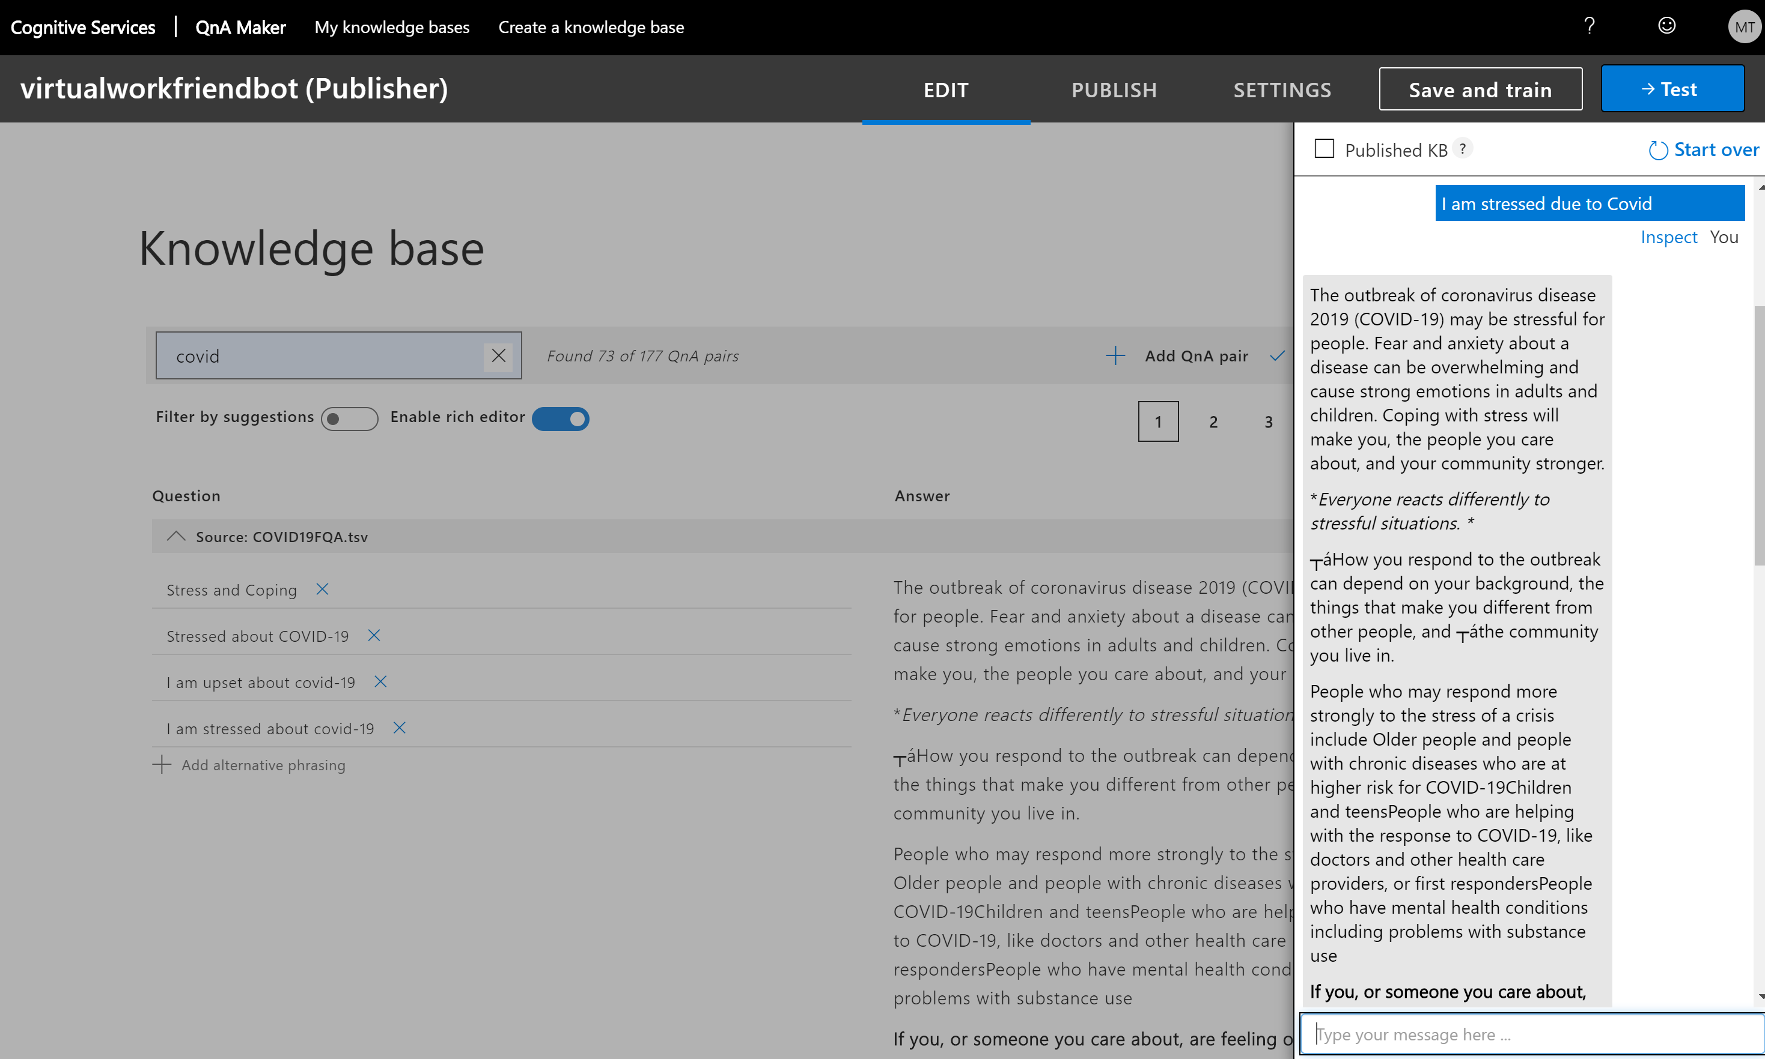
Notes:
The new architecture has the data and runtime hosted in your Azure subscription.
QnA data is hosted within your Azure compliance boundary
You can turn any document, or FAQ url into a multi-turn conversation in just 3 quick steps with absolutely no code.
Just go to qnmaker and select create a Knowledge base. If you have already provisioned a QnA Maker service in your Azure subscription, then just select it when creating the KB,
Paste the FAQ url like we used CDC’s FAQ url for our Covid-19 KB or you could also upload a work or pdf document,
You can then choose to include a chatty bot personality which will respond to small talk; it adds a couple hundred Qs & answers to the KB,
QnA maker parses the web page and creates a bunch of Q&As
You can then use Save and train to train your bot and then publish it

Slide 12
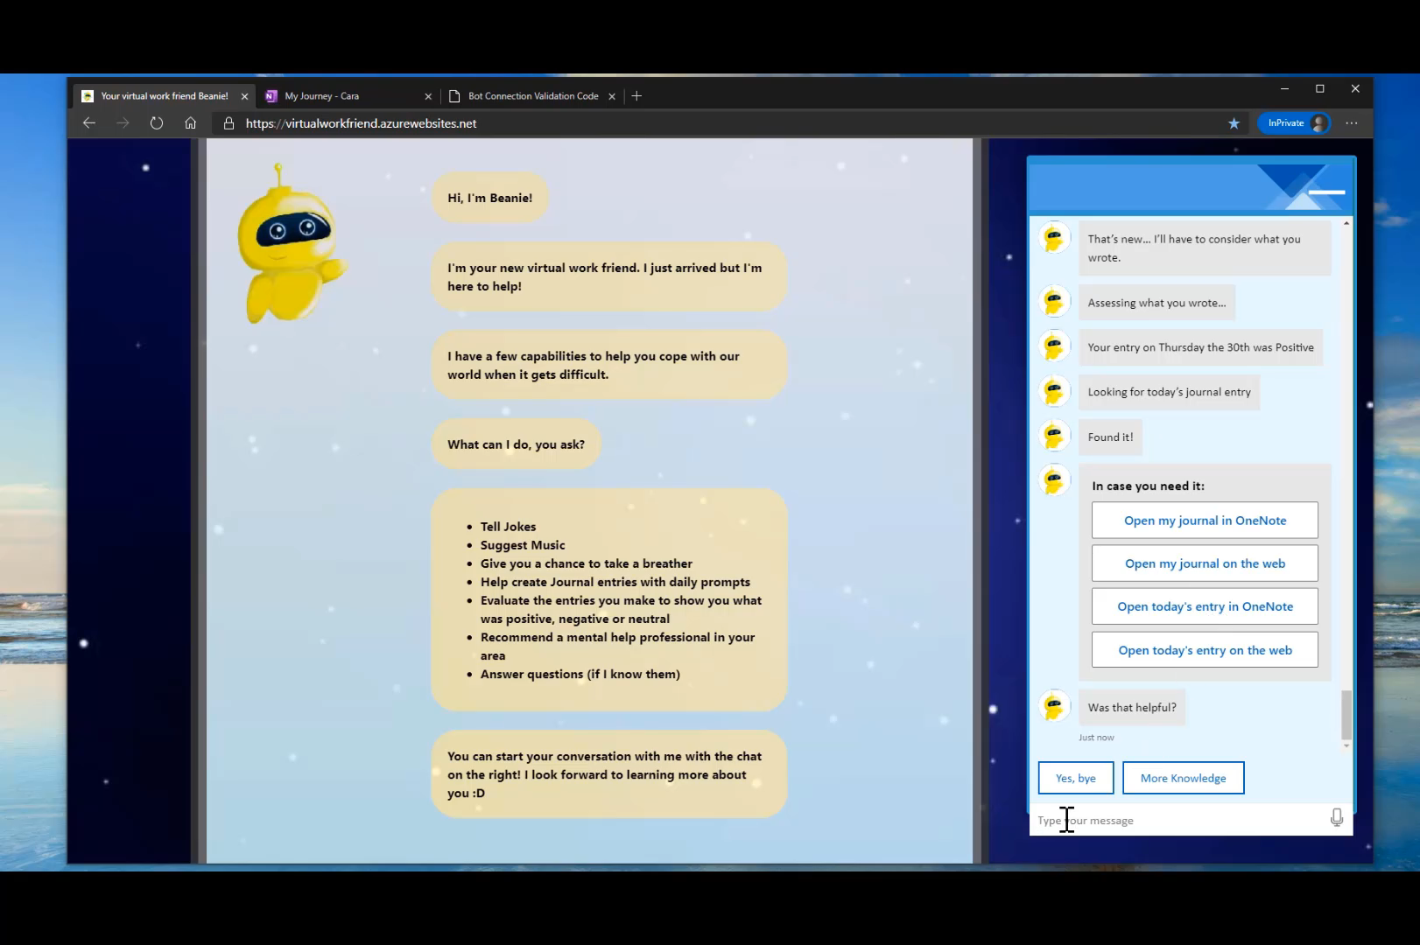
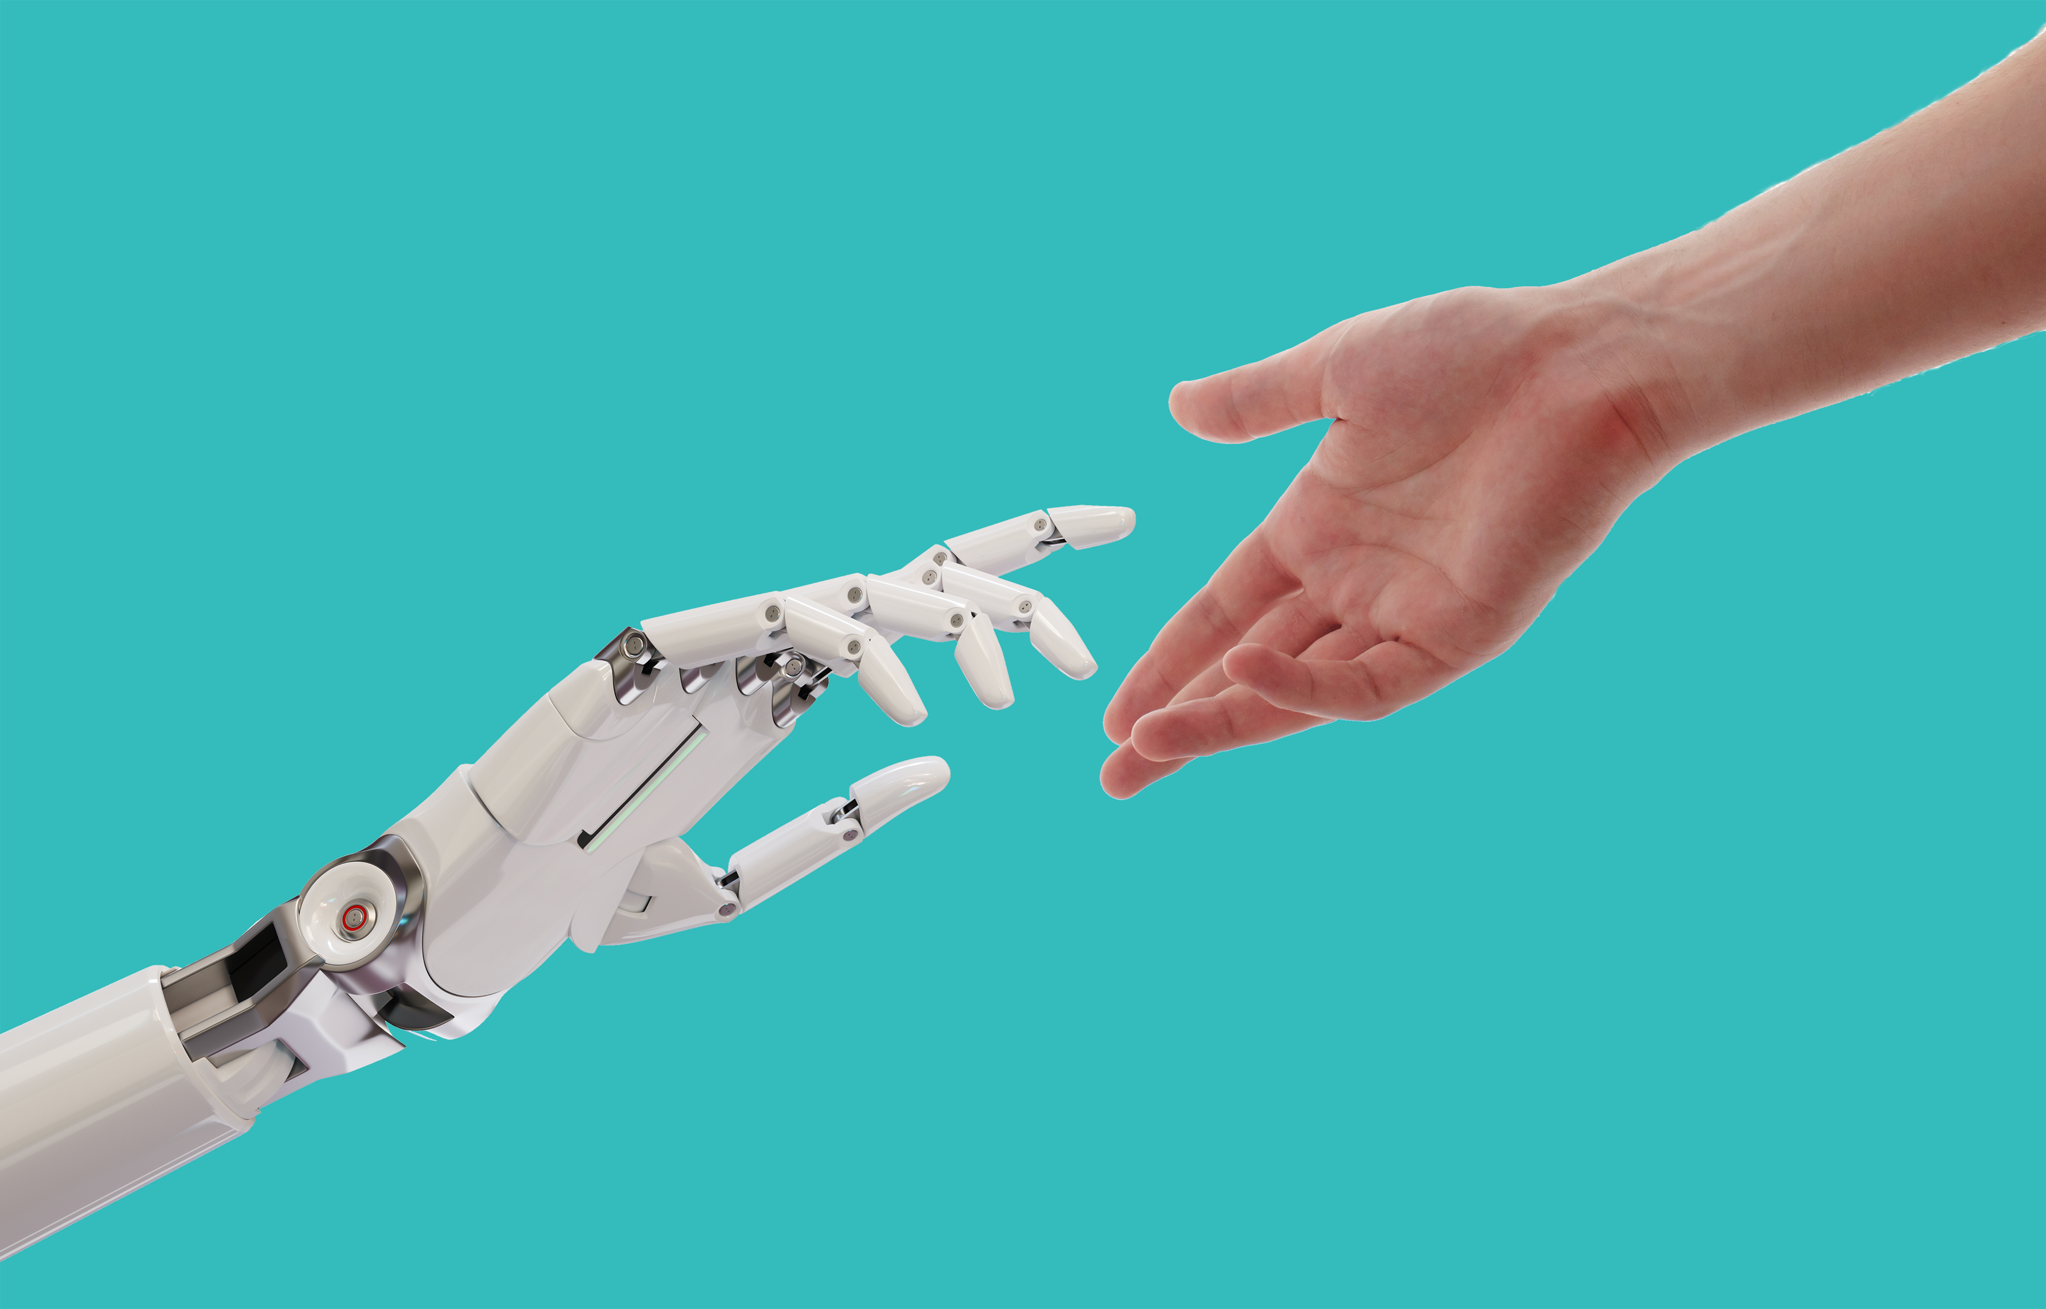
Escalation

Slide 13
Challenges
Version update
Feature Integration
Limited Doc
Skill Level

Slide 14
Can Be Extended for Compliance
GDPR compliant With built–in compliance constructs to support user’s data subject rights (DSR)
ISO 27001 and 27018 certified By aligning to globally recognized information security best practices
HIPAA compliant With comprehensive safeguards to protect personal health information at rest and in transit
CSA STAR Gold certified By demonstrating exceptional cloud security management capabilities

Slide 15
Why should you care?
Low hanging fruit, short sales cycle – Great for ACA last mile!
Easy to pitch – Very tangible, quick deploy, and low cost
Acquire new customers & use as conversation starter
Notes:
Low hanging fruit, short sales cycle – Great for ACA last mile! - Minimal effort for sellers; average monthly consumption of $3k
Easy to pitch – Very tangible, quick deploy, and low cost - Deployable in as little as 3 weeks
Penetrate new customers & use as conversation starter - Chatbots are exciting and compelling for a wide range of customers

Slide 16
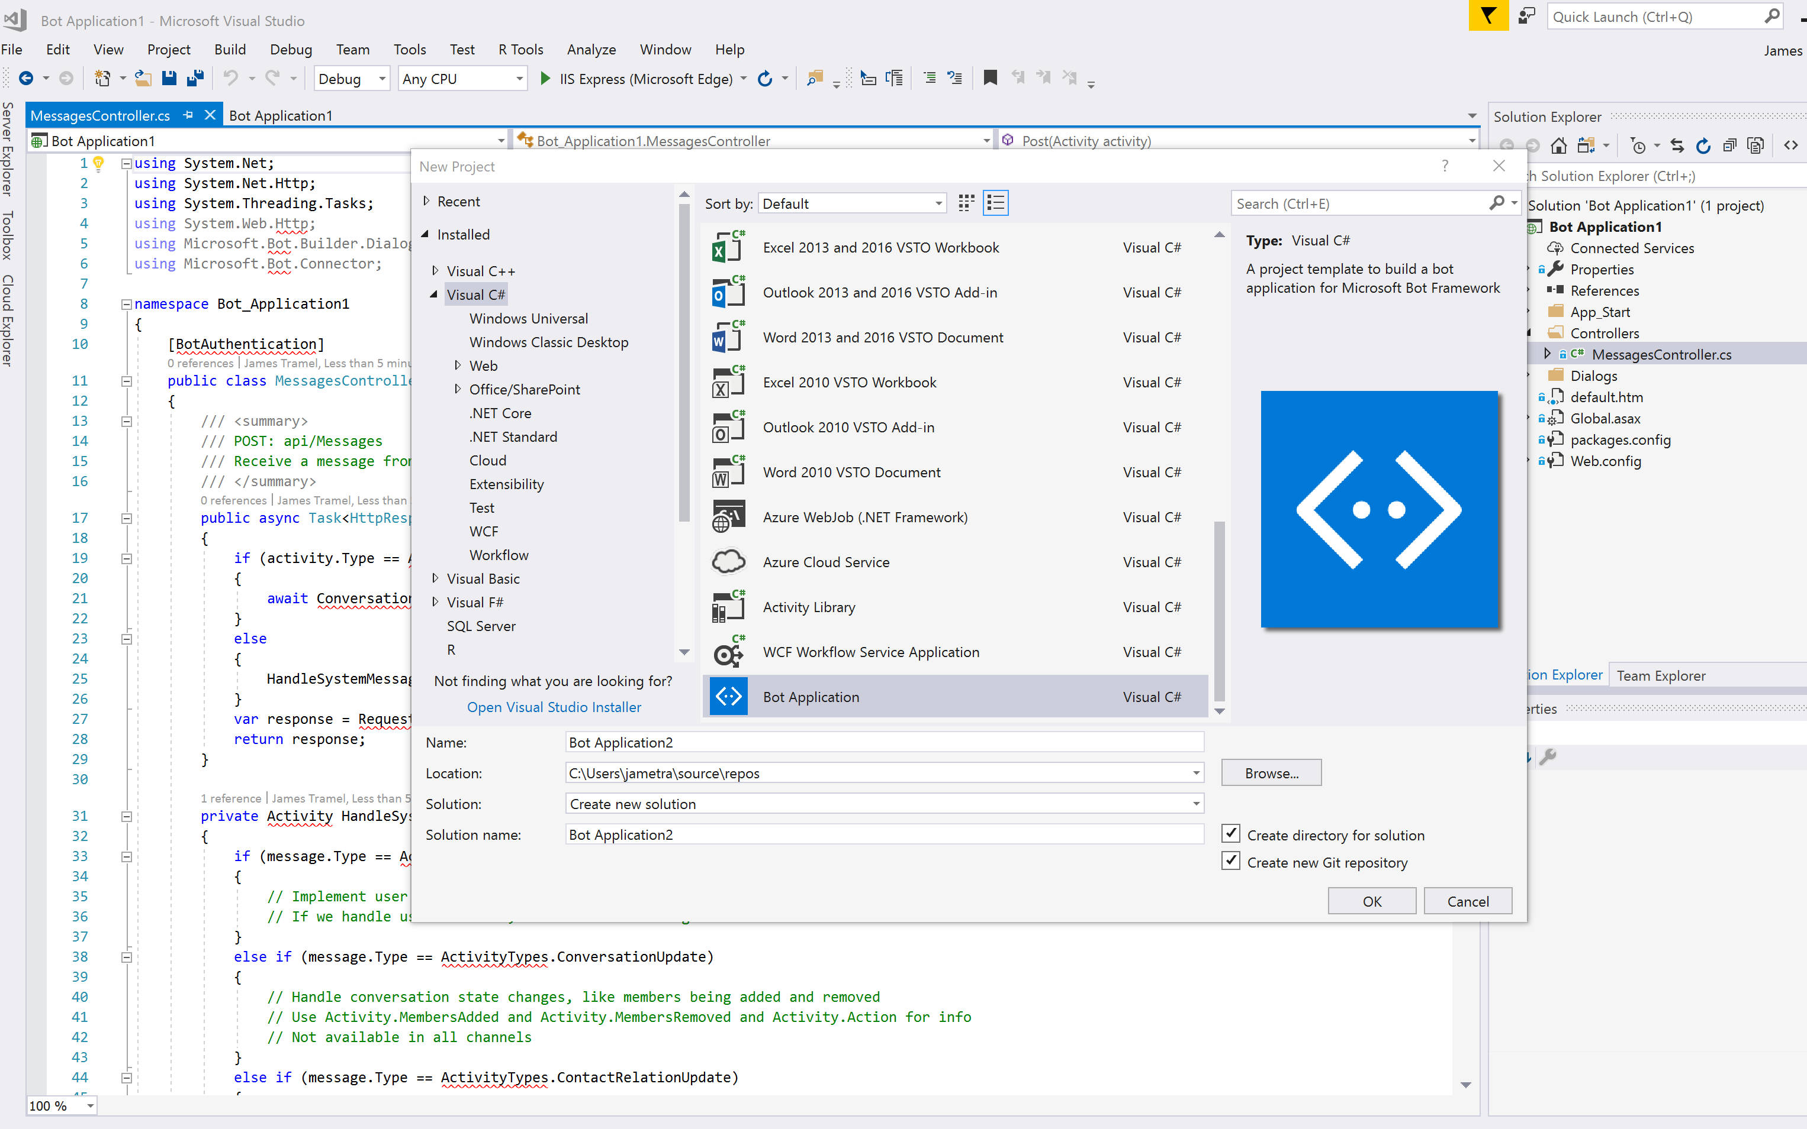
ACR: Bot application with Bot Framework
Bot Builder / Bot SDK
=
= USD 50
{Code }
Notes:
Azure Bot Service and Bot Framework provide tools to build, test, deploy, and manage intelligent bots, all in one place. Through the use of modular and extensible framework provided by the SDK, tools, templates, and AI services developers can create bots that use speech, understand natural language, handle questions and answers, and more.
Azure Bot Service - S1 tier, 100000 messages in Premium Channel (West US) = $50 USD monthly
Azure Bot Service offers both the Web App Bot which automatically deploys a Bot on Azure on your behalf, and the Bot Channels Registration offering that enables you to host your bot wherever you like.

Slide 17
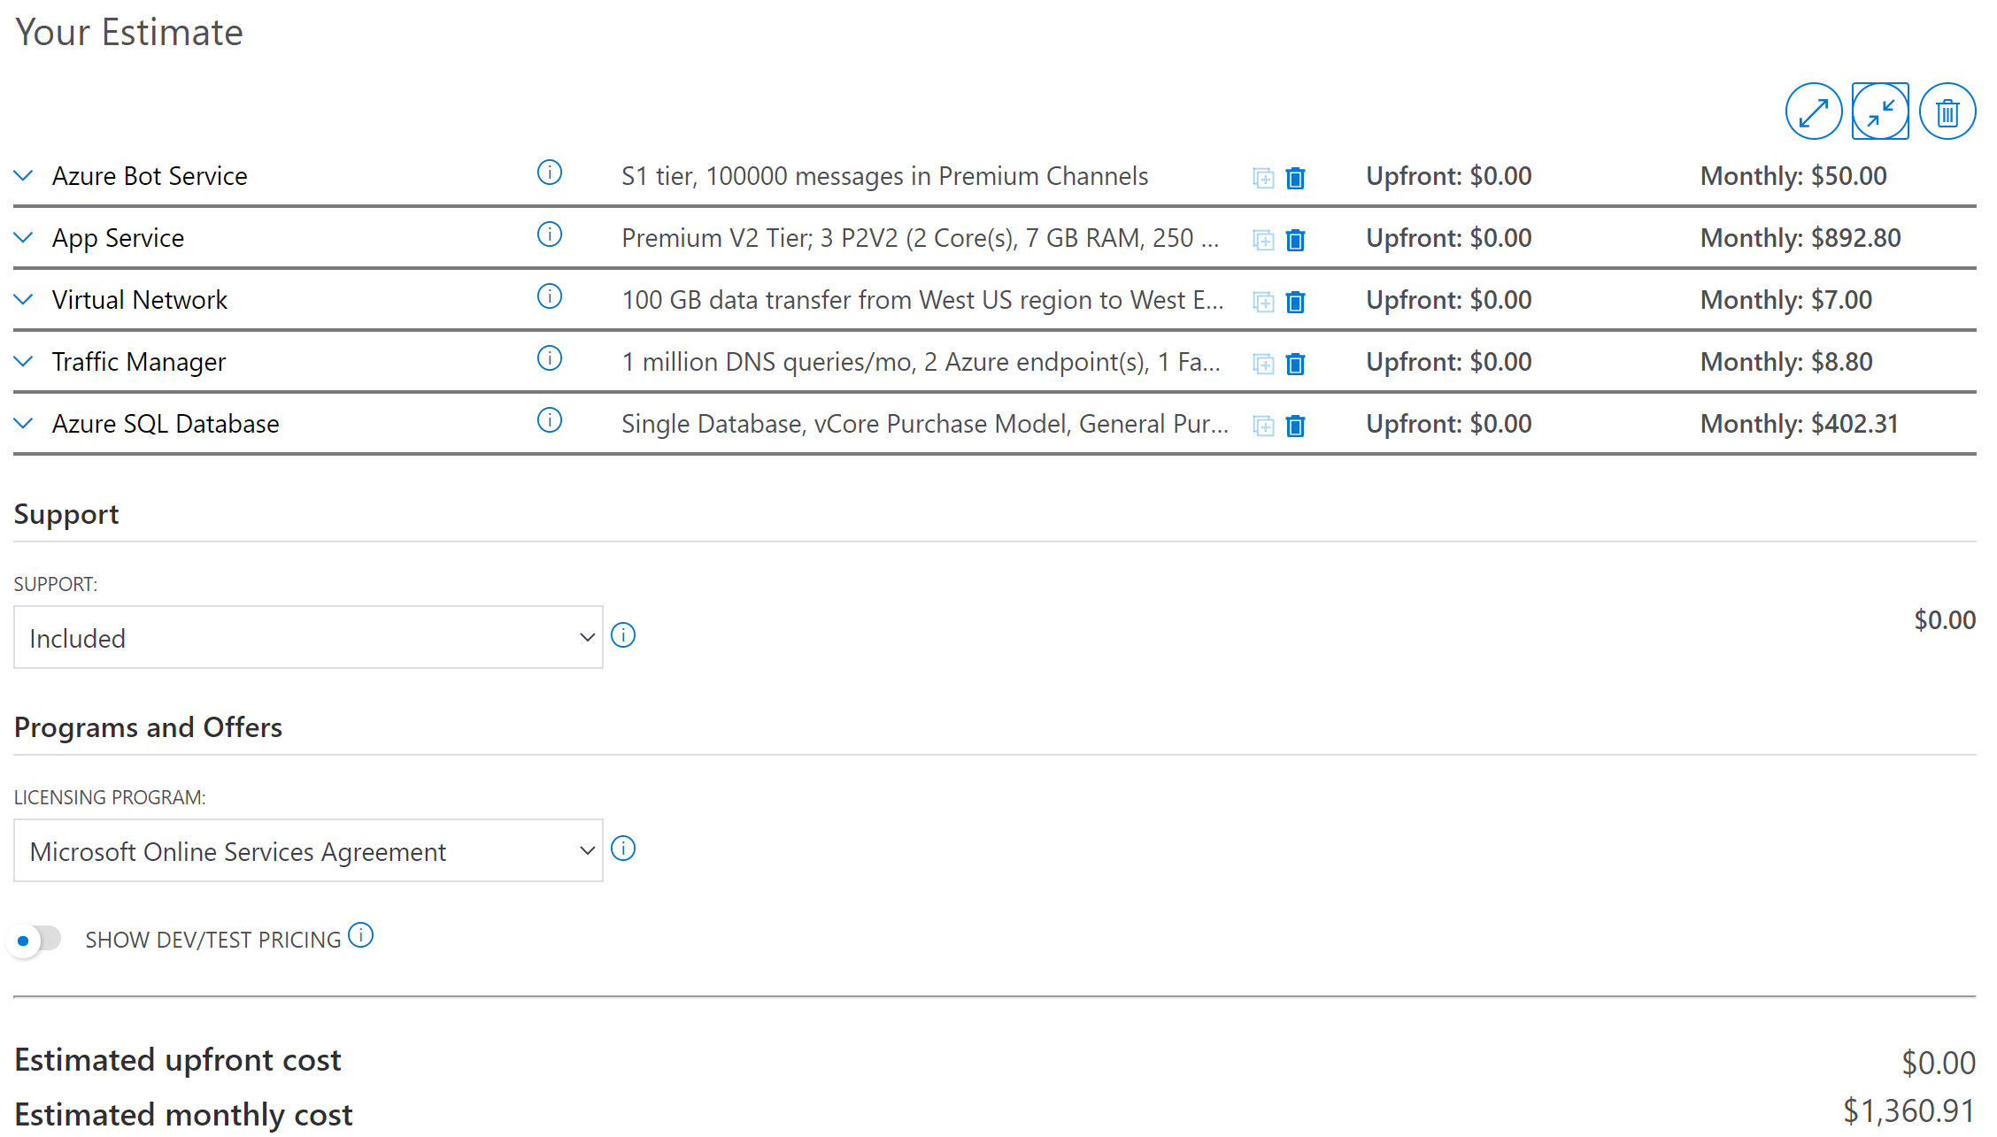
Bot + Platform & Infrastructure Services
USD 1360.91
Notes:
We haven’t added any Support –
Developer – $29 | Developer support is for companies or individuals using Azure in a non-production environment or for trial and evaluation.
Standard – $100 | Standard support is for small- or mid-size companies with minimal business-critical dependence on Azure
Professional Direct – $1000 | Professional Direct support is for mid-size to large companies with substantial business-critical use of Azure.

Slide 18
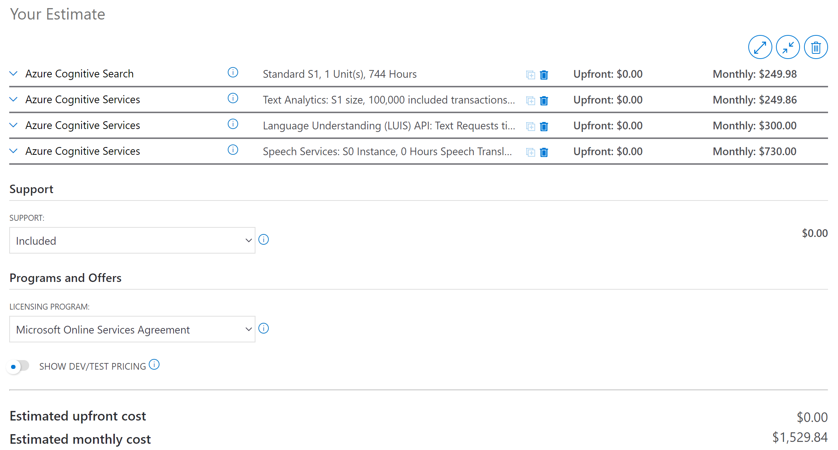
+ Cognitive Services
= USD 2890.75 per month
USD 1360.91+
Notes:
We haven’t even included -
Azure Machine Learning capabilities
Stream Analytics
Data Lake
Event Grid
App Insights
Nor have we included the pricing for Office 365

Slide 19

Share our architecture and solution IP aka.ms/mentalhealthbot
Recommend the Bot-in-a-Day Workshop to your customers aka.ms/biad
Accelerate adoption with an architecture review or Proof-of-Concept

Slide 20
aka.ms/mentalhealthbot
Feedback
Share
Contribute

